Slide 1
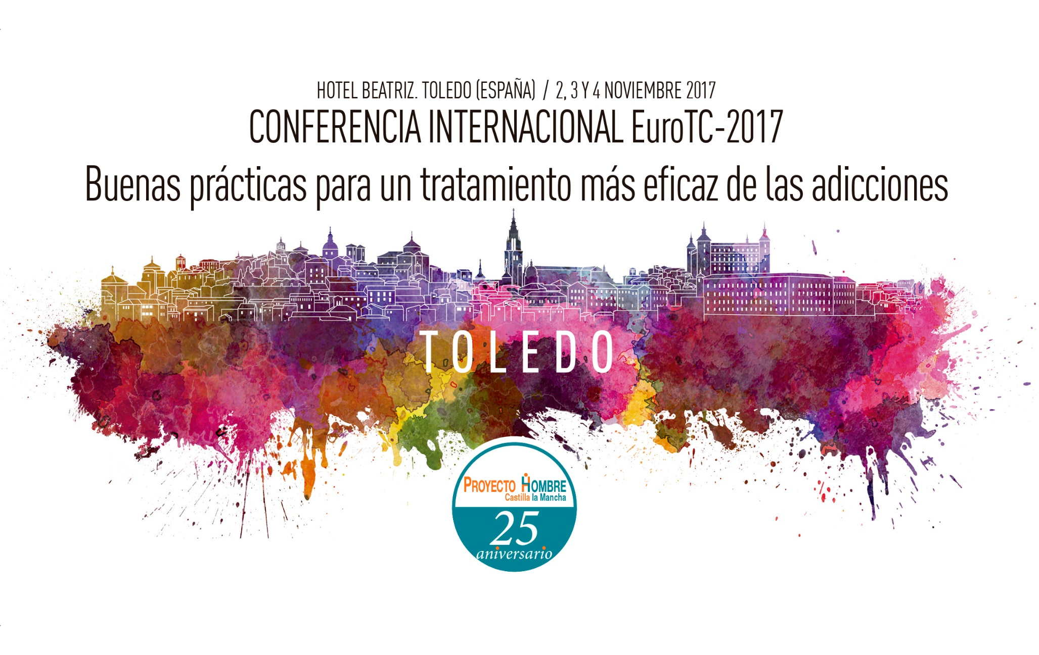
“
Hotel Beatriz, Toledo. SPAIN. November 2,3 and 4, 2017 "GOOD PRACTICES FOR MORE EFFECTIVE TREATMENT OF ADDICTIONS

Slide 2
Organizes…
Proyecto Hombre Castilla la Mancha celebrates 25 years working in the field of addictions and for this reason, this year will organize the International Conference of EuroTC, in collaboration with the Asociación Nacional Proyecto Hombre

Slide 3
EuroTC is a network of professional addiction treatment centers covering 12 European countries.
The network provides the exchange of knowledge between professionals and users, which takes place through meetings and conferences, therapeutic, creative and sports activities, training and exchange of personnel.
Euro-TC is member of other networks and advisory bodies such as the Civil Society Forum on the European Commission's Consultative Body on Drugs, the Vienna NGO Forum on National Narcotic Drugs (UNODC Consultative Body), ICAA - International Council on Alcohol and Drug Addiction, IREFREA and the newly created ECO network in Asia.

Slide 4
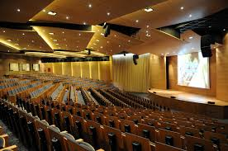
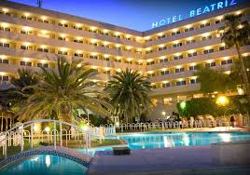
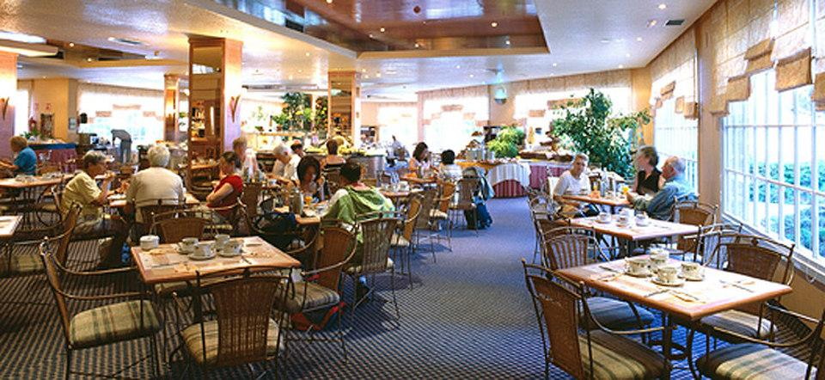
Place of celebration: Hotel Beatriz. Toledo (Spain)

Slide 5
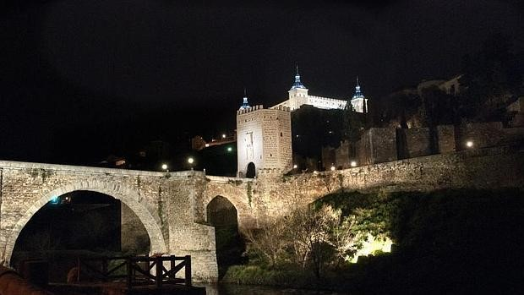
Objective…
Meeting between associations, professionals and people involved in the treatment of addictions, for the exchange of experiences and good practices, mutual enrichment and search for improvement and innovation in our daily work.

Slide 6
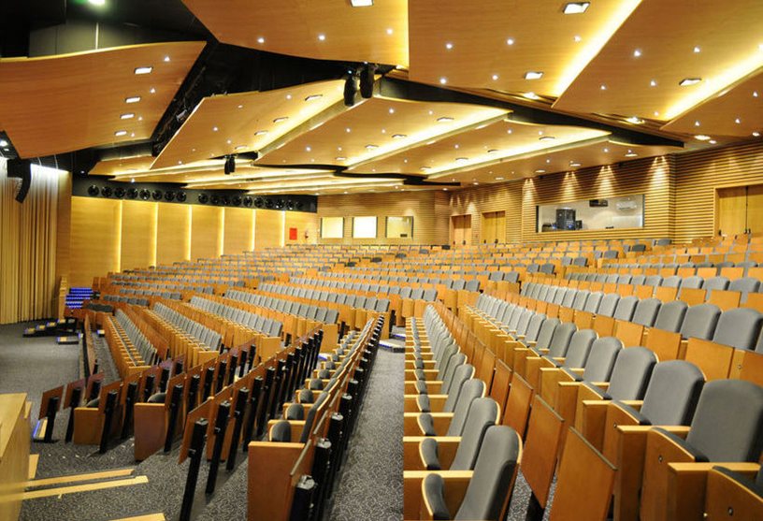
Contenido…
Plenary Sessions, with keynote addresses from
renowned experts:
Round tables with the participation of national and international representatives:
European drug plan and cooperation with civil organizations
Experiences of international scope in the treatment of addictions: Ukraine, Croatia, Iran, Mexico, Nicaragua and Colombia will be represented.

Slide 7
Workshops on good practices in the treatment of addictions. A total of 13 workshops will offer the opportunity to make contact with some of the most innovative practices in the treatment of addictions that both in the APH and other international organizations are currently being applied, with an eminently practical and experiential.
Communications/Poster: In line with the participative spirit of this meeting we want to make known the numerous and enriching practices of professionals in our sector, with a space that will remain exposed throughout the Conference.

Slide 8
Workshops | Monitor | Origin
Mindfulness | Ana Gutiérrez | Spain
Happiness and wellness | Francisco J. Sainero | Spain
Psychodrama in the treatament of addictions | Julio Nuño | Spain
Therapeutic equipment care | Gabriel Roldán | Spain
Sensory memory and massage | Alicia Lorduy/Paloma B. | Spain
Support for maternity | Nicoletta Capra | Italy
Life script | Daniel Muñoz Peñas | Spain
Enneagram | Victor Rodríguez/Pedro Pedrero | Spain
Family constellations | Horst Brömer | Germany
Theater terapy | Cszoubou Mclhaolinecz | Hungary
Creative art therapy | Ramona Ritter-Weilguni | Austria
Family and prevention: the active participation of parents | Fernando Méndez | Portugal
Pedagogy of Humor | Jesús Damián | Spain

Slide 9
Communications / Poster
They can be investigations about the addictions work (prevention and treatment) or good practices in the treatment of addictions, novel experiences in this field, etc.
At the end of the Conference, three posters will be chosen to be explained in a round table in the Plenary.
We want to encourage professionals and collaborators to participate in this section.

Slide 10
Program
Thursday, november 2
11:00 Reception and accreditation attendees
12:00 Official opening of the Conference. Opening table: local authorities and representatives organizing entities
12:30 Inaugural lecture: "Addiction is not a disease: does it matter?“
Speaker: D. José Ramón Fernández Hermida. Professor of the Faculty of Psychology of the University of Oviedo. Co-director of the Master in Addictions Project Hombre and the University of Oviedo.
13:30 “Evolution of intervention in addictions over the last 25 years, alternatives and good practices".
Prof. Dr. Paolo Stocco (Honorary President of Italy at EuroTC and Director-President of the Villa-Renata Therapeutic Center in Venice) and D. Luis Bononato (President of the National Association of Man Project)

Slide 11
14:00 LUNCH
15:30 Workshops: "Good practices for effective treatment of addictions"17:30
Break: 15´
19:30 End of the working day
Friday, november 3
9:00 Round table: European drug plan and cooperation with civil organizations
Moderator: Bernardica Juretić.
10:00 Round table. International experiences in the treatment of addictions
Participants:
- Colombia: Padre Gabriel Mejía (Hogares Claret)
- Nicaragua: Dª Gissel Leal (CENICSOL-Managua)
- Ucrania: D. Alexander Akhmov
- Irán: D. Abbas Seylamizade (Rebirth Society)
- Mexico: Dª Carmen Fernandez Carceres (CIJ Mexico)

Slide 12
11:30 Coffee-break
12:oo Workshops
14:00 Lunch
15:30 Workshops
17:30 End of the working day
Saturday, november 4
9:30 Posters presentation selected
10:30 Closing paper: "New concept of man and reality"
D. Gonzalo Rodriguez-Fraile: Founder of the Foundation "Development of the conscience"
12:00 Closing of the Conference and Closing Table

Slide 13
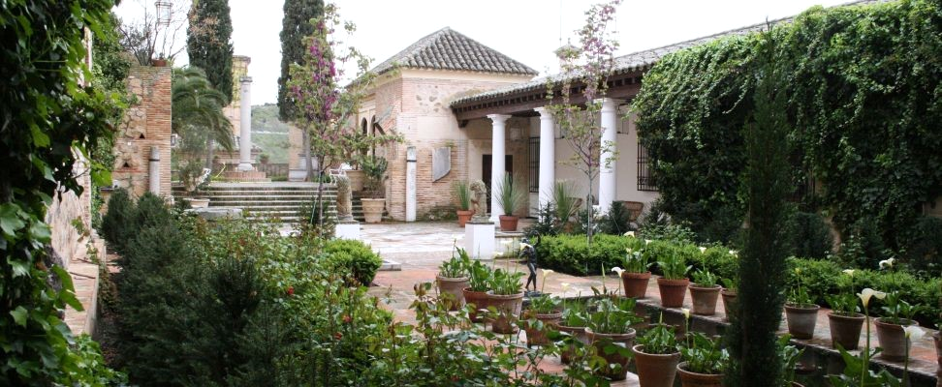
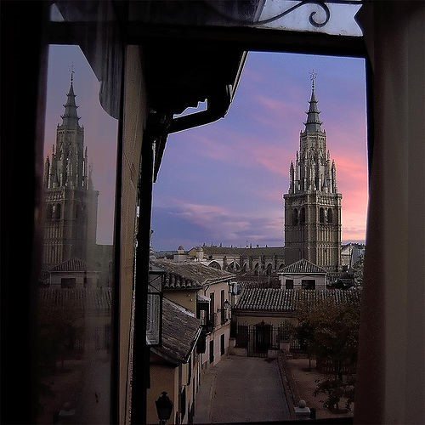
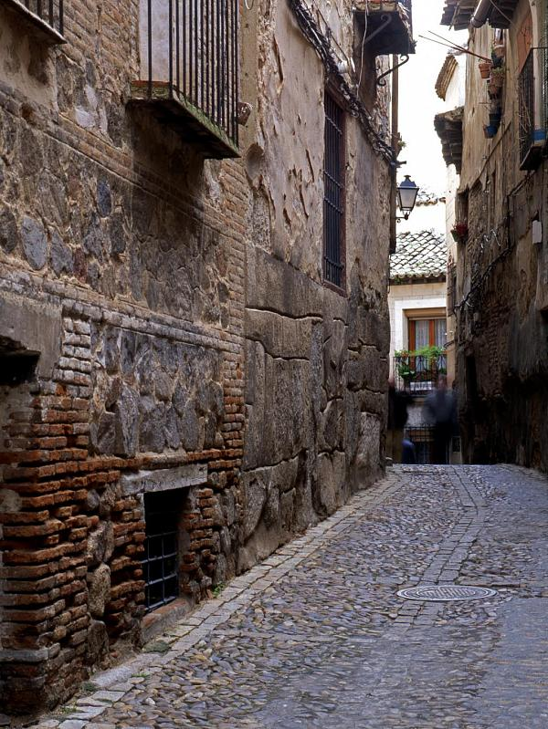
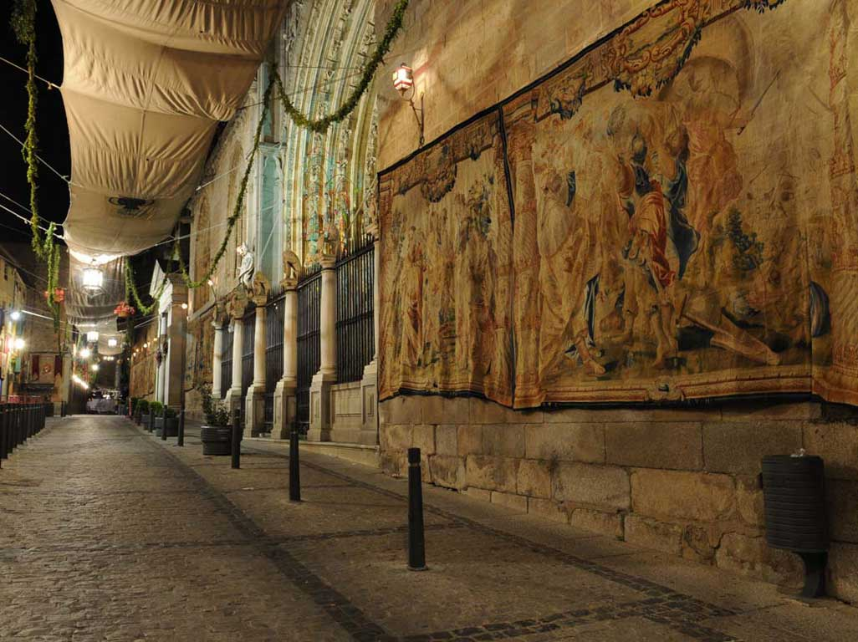

Slide 14
Parallel program "time of meeting and coexistence"
The city of Toledo, declared a World Heritage Site by UNESCO in 1986, is nestled on a rocky promontory surrounded by the Tagus River . Getting lost in its narrow streets, squares and gardens make your visit an experience without comparison. Made to walk along its long slopes and look over its horizon, a number of monuments are erected over Toledo, surrounded by unforgettable corners and spaces that awaken sensations in the eyes of those who visit it and of those who are lucky enough to live in it.

Slide 15
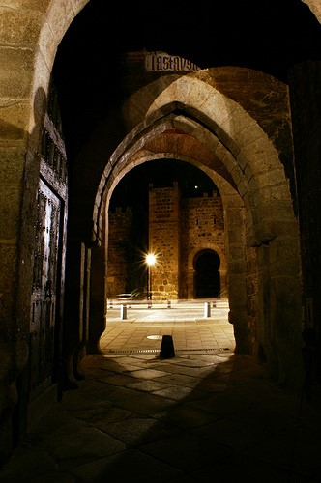
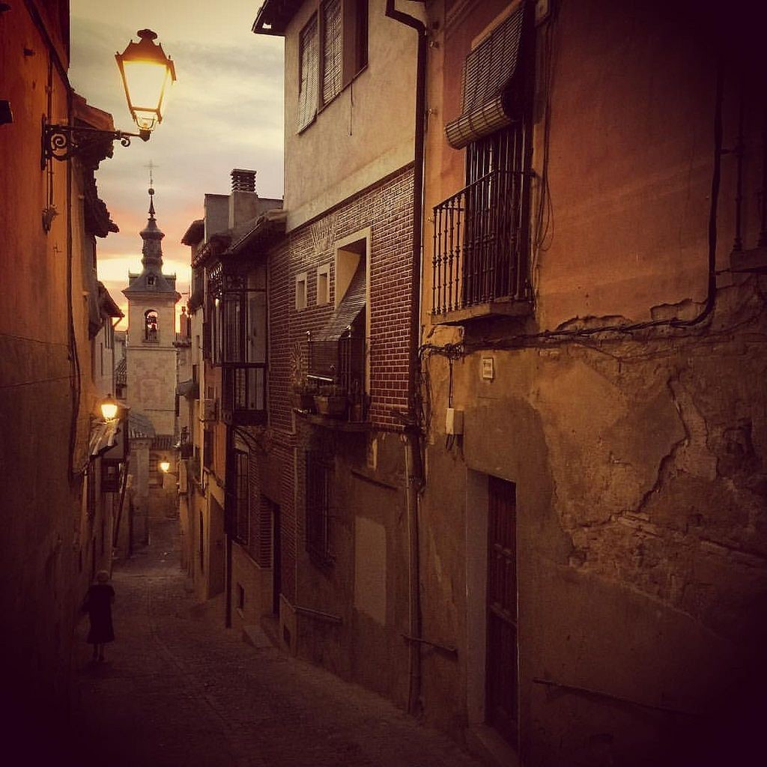

Slide 16
Cultural Program…
Thursday, november 2
20:00 Night guided tour of the city of Toledo.
Friday, november 3
20:30 Concert in the Cathedral of Santa María de Toledo in charge of Amancio Prada.
The "Spiritual Canticle" of San Juan de la Cruz.

